Slide 1
Free Energy in a Circumplex Model of Emotion

Slide 2
Previous models link free energy to emotion, mainly focusing on valence.
Circumplex Model represents emotions on a valence-arousal spectrum.
Valence derived from utility vs. expected utility.
Arousal related to the entropy of posterior beliefs.
Simulation of artificial agents in search tasks shows emotional variability. ​

Slide 3
Introduction to Emotions
Internal states influencing behavior and cognition.
Critical for a comprehensive understanding of intelligence.
Discrete Emotion Theories Emotions as discrete states.
Fear associated with the amygdala.
Anger, joy, disgust, fear, sadness, surprise.
Dimensional Approaches
Circumplex Model
Fluid Boundaries
Brain Activity

Slide 4
Discrete vs. Dimensional Models
Discrete Models:
Evolutionary basis.
Cross-cultural evidence.
Challenges with "edge cases" and defining discrete categories.
Dimensional Models:
Accommodate fluid transitions between emotions.
Preferred for granularity and detailed emotional state space.

Slide 5
Previous Active Inference Formulations of Emotions
Smith et al. (2020):
Emotional state inference using exteroceptive, proprioceptive, and interoceptive observations.
Hierarchical model presupposing valence and arousal.
On learning explicit, discrete representations of emotional states based on feedback, rather than on the factors constituting emotional states and their behavioral modulation.
Joffily and Coricelli (2013):
Valence as interaction between time derivatives of free energy.
Valence provides feedback on learning process.
Positive valence: Rapid decrease in free energy (happiness).
Negative valence: Slow learning rate (adaptation to volatility).
THesp et al. (2021):
Hierarchical model of emotional valence.
Valence as changes in expected precision of action model ("affective charge").
Precision: Confidence in predictions and actions.
Positive valence: Riskier behavior (increased confidence).
Negative valence: Conservative exploration (adjusted confidence).

Slide 6
From Free Energy to a Circumplex Model of Emotion

Slide 7
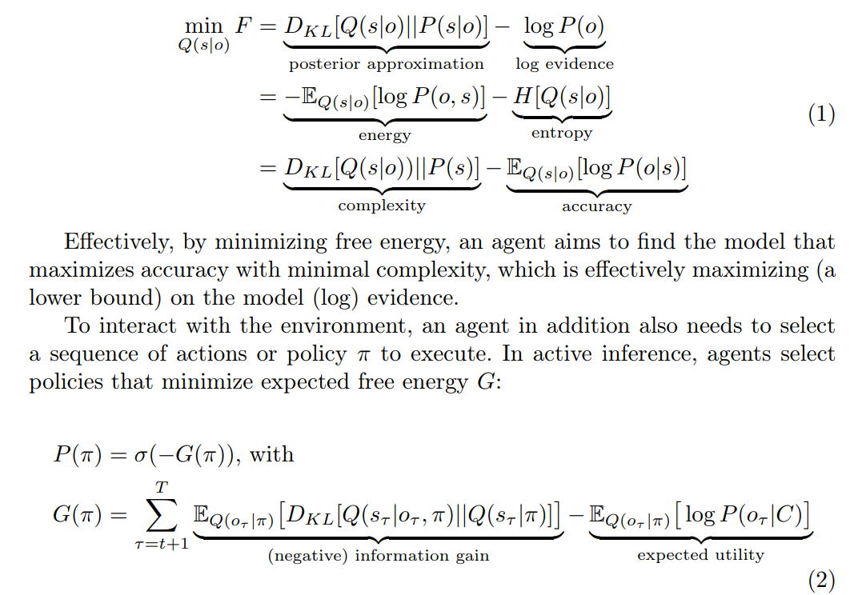
Circumplex Model of Emotion:
Emotions organized along two dimensions: valence and arousal.
Aim: Derive these dimensions from an active inference agent’s free energy levels.

Slide 8


From Free Energy to Valence
Define emotional valence in terms of active inference.
Simple, non-hierarchical model that is psychologically interpretable.
Valence (V) = Utility (U) − Expected Utility (EU)
Utility of Observation (U):
Desirability of an observed outcome.
Example: High utility for observing a preferred outcome (e.g., red apple for a robot).
Expected Utility (EU):
Anticipated desirability based on beliefs and policies.
Example: Predicted likelihood of encountering preferred outcomes based on past experience and current plan.

Slide 9
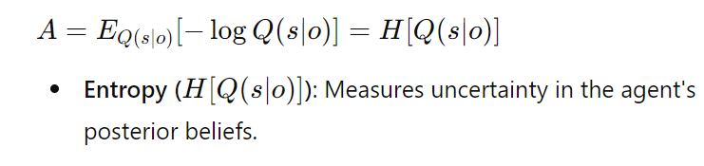
From Free Energy to Arousal
Arousal and Uncertainty
Linked to increased amygdala activity and uncertainty.
Reflects the need to update beliefs for allostasis.
Allostasis
Achieving stability through predicting and responding to environmental changes.
Reducing uncertainty in posterior beliefs to maintain internal stability.

Slide 10
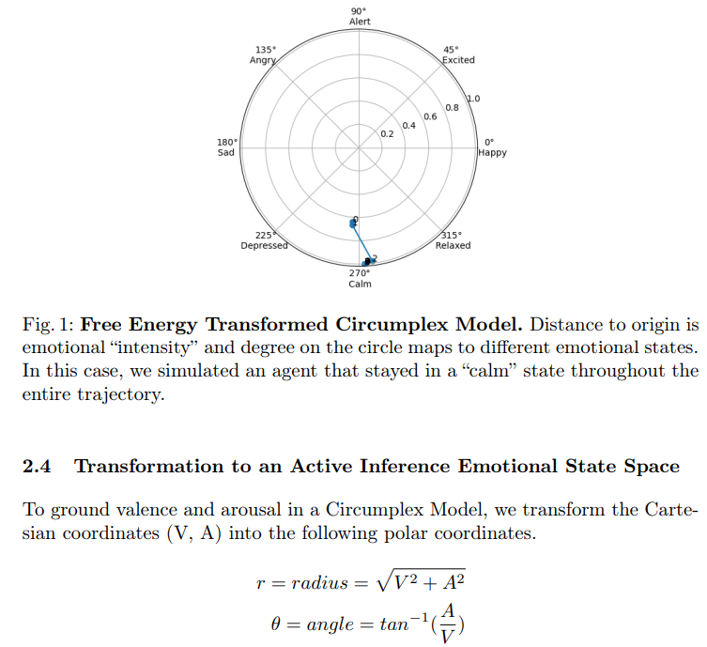
Transformation to an Active Inference Emotional State Space

Slide 11
Initial Setup Correct wallet location: Location 3
Agent's prior belief: The wallet is at Location 1
Location 1: The agent starts here with a high belief (certainty) that the wallet is here.
Observation: The agent does not find the wallet at Location 1.
Belief Update: The agent updates its belief based on the observation.
Calculating Valence and Arousal:
Valence Calculation:
Utility (U): The log probability of observing the wallet given the agent's prior belief.
Initially: U=logP(wallet at Location 1∣prior)=log(0.95)
After not finding the wallet at Location 1: U=logP(no wallet at Location 1)=log(0.05)
Expected Utility (EU): The agent’s expected utility based on its belief distribution.
Initially: EU=EU=EQ(o∣s,π)​[logP(o∣C)]
Assume EU=0.9 (high confidence)
After not finding the wallet: EU=0.1 (updated lower confidence)
Valence (V): V=U−EU
Initially: V=log⁡(0.95)−0.9=−0.025−0.9=−0.925 (neutral valence)
After not finding the wallet: V=log⁡(0.05)−0.1=−2.9957−0.1=−3.0957(negative valence)

Slide 12
Arousal Calculation:
Entropy (H): The uncertainty in the agent’s belief about the wallet’s location.
Initially: High certainty at Location 1, low entropy: H=−Q(s∣o)logQ(s∣o)
Assume H=0.1 (low arousal)
After not finding the wallet: Increased uncertainty, higher entropy.
Assume H=0.8 (high arousal)
Emotional States:
Initial State: Calm (low arousal, neutral valence)
Valence:−0.925
Arousal: 0.1
After Observation: Angry (high arousal, negative valence)
Valence: −3.0957
Arousal: 0.8

Slide 13
thank you

